Slide 1

Creep failure chronicles
An in-depth investigation of Ti-6Al-4V alloy bolts
Group- G7
2011049 Anabil Dey
2011050 Shadman Nahian
2011051 Farin Nowshin
2011052 Saiful Islam Nadim
2011053 Md. Atik Faisal
2011054 Jihan Mahbub Khan

Slide 2
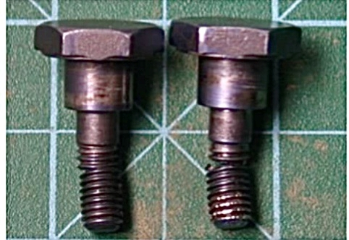
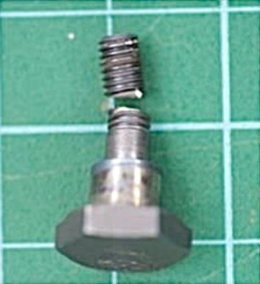
01
CASE
Investigation of in-service creep failures of Ti-6Al-4V alloy aircraft bolts installed on a landing gear component

Slide 3
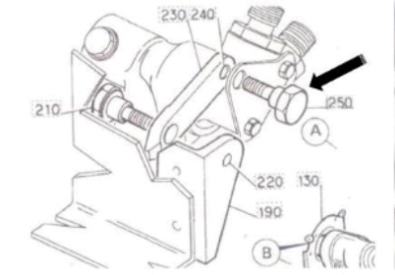
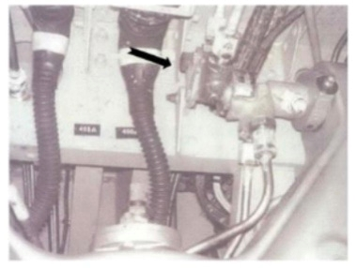
Info
02
Three fractured Ti-6Al-4V bolts of three approximately 20-year-old jet aircraft were submitted for examination. These failures occurred within a short interval, approximately three years. Each of these ruptured bolts was attached to the rotatory selector valve of the nose landing gear as shown in the figure.

Slide 4
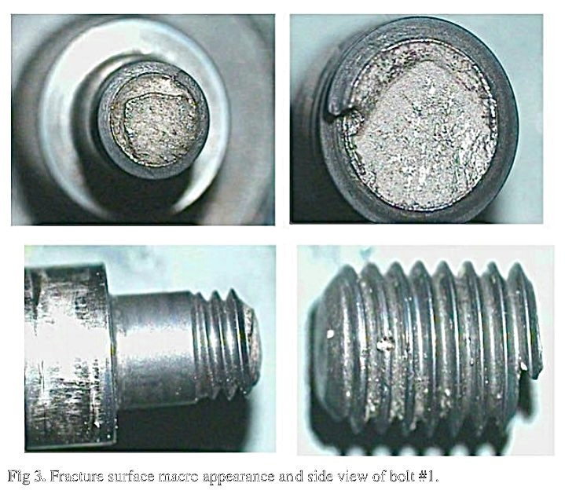
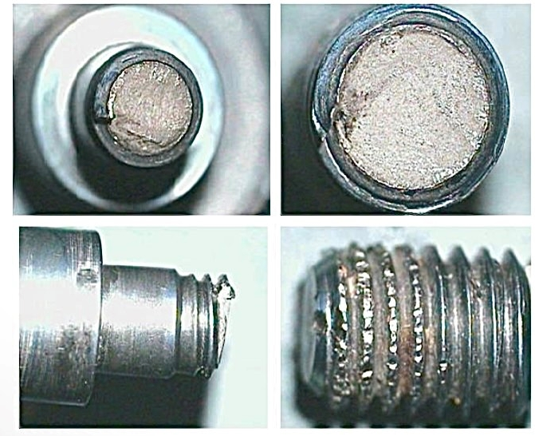
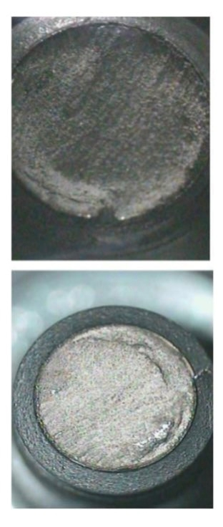
03
INVESTIGATION
VISUAL INSPECTION:
Visual Inspection of Bolt 1
Visual Inspection of Bolt 2
Visual Inspection of Bolt 3

Slide 5
04
INVESTIGATION
VISUAL INSPECTION ANALYSIS:
The bolts fractured in the vicinity of the last engaged root
No macroscopic deformation or corrosion
Large number of reflective facet
Some axial cracks on the bolt surface similar to void
Observed ductile fracture morphology

Slide 6
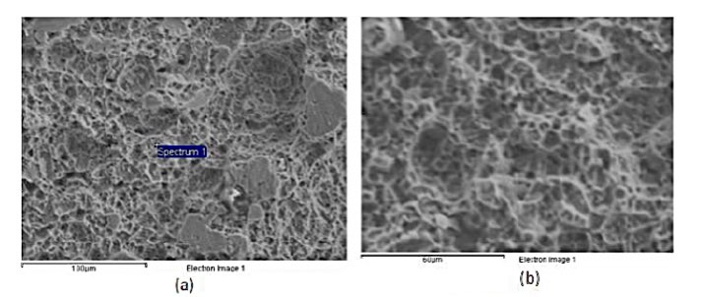
05
SEM ANALYSIS
For SEM (Scanning Electron Microscope) analysis, the specimen was dipped into an acetone solution and cleaned with an ultrasonic washing machine . It revealed:
Small granular white objects
Dimples in margin of fracture surface
Micro void coalescence
All indicative of a clear ductile fracture

Slide 7
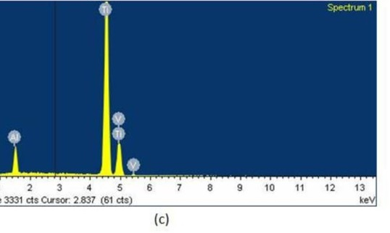
06
EDX ANALYSIS
The chemical analysis of specimen confirmed a Ti-6Al-4V alloy
No thermal oxidation occurred
Did not reveal any material deficiency that would have precipitated failure

Slide 8
07
Temperature Attributes
The melting temperature of Ti-6Al-4V alloy is : 3000-3272 °F
For creep to occur temperature required : 0.5Tm( Melting temperature of the alloy)
For this case temperature : 1500-1600 °F
Temperature near the landing gear during high-stress conditions or heavy breaking : 932°F
Temperature of landing gear during flight : 212-392°F

Slide 9

FINDINGS
08
Visual inspection & SEM analysis confirms
ductile Failure
EDX analysis revealed that the material was in fact a Titanium alloy & any material deficiency was absent
Ultimately the analysis combined with the
temperature attributes indicates a
Low Temperature Creep Failure

Slide 10
MECHANISM
09
From the findings, we understands it is a creep mechanism.
Creep can be a form of diffusion creep which is a mechanism for deformation of crystalline solids. In this case the creep
Occurred at relatively low temperature.
At low temperature grain boundary diffusion became more prominent than lattice diffusion
Because of the Titanium alloy’s finer grains, it became more susceptible to creep failure. As finer grains have more grain boundaries to transport vacancies or disloactions.

Slide 11
MECHANISM SEQUENCE
10
1. Low-Temperature Conditions
For this case creep can be seen at relatively low temperatures
the activation energy for lattice diffusion is high.
2. Diffusion along Grain Boundaries
Low temperature creep involves the diffusion of atoms along grain boundaries
Localized deformation and grain boundary sliding.
3.Grain Boundary Sliding
This sliding contributes to the overall deformation
without significant dislocation motion within the grains.

Slide 12
MECHANISM SEQUENCE
11
4.Dislocation movement
Dislocation interact with atoms
Contribute further deformation
5.Grain boundary migration
Migration of grain boundary occurs
Results in rearrangement of grains
6.Potential for Cracking
initiation of cracks along grain boundaries
These cracks can propagate and eventually result in material failure.

Slide 13
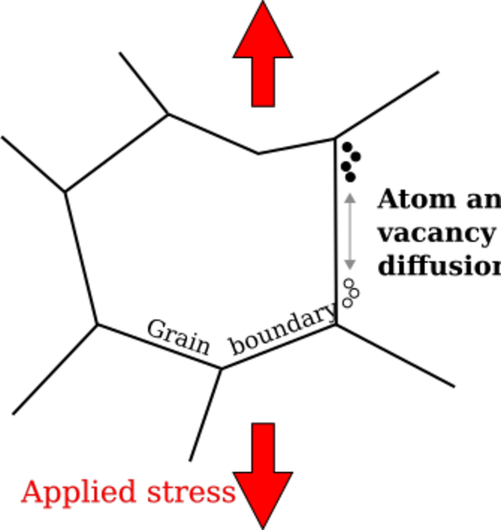
CREEP PICTURE
12
Figure : Mechanism of creep

Slide 14
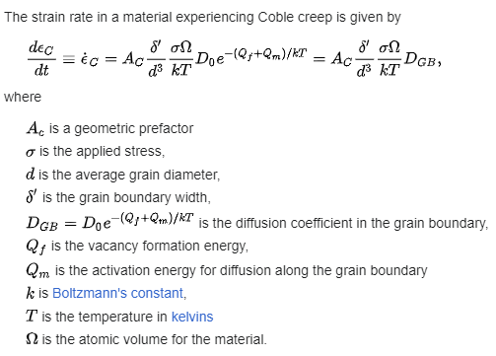
Mathematical formulation
13

Slide 15
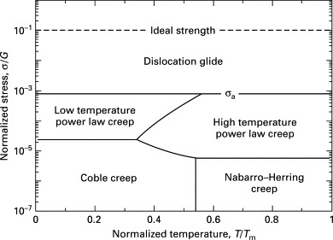
GRAPHICAL ANALYSIS OF CREEP FAILURE
14
From this graph ,it is visible evident that at low temperature Creep can occur

Slide 16
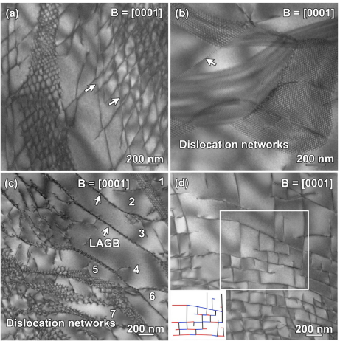
Microstructure analysis
15
Fig.a: Hexagonal and rhombohedral dislocation networks,
Fig.b: Intersection of dislocation networks,
Fig.c:LAGBs formed by dislocation networks,
Fig.d: Quadrilateral dislocation structure in equiaxed a grains at the applied stress of 0.8σ_{0.02}
(the different colors in the illustration represented dislocations with different Burgers vectors).

Slide 17
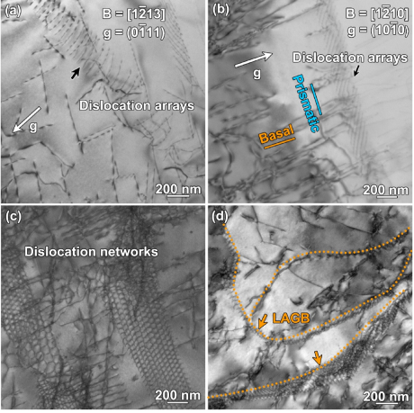
How Creep failure occurs at Ti-6Al-4V bolts
16
Fig: BF-TEM micrographs showing (a) dislocation arrays,
(b) small misorientation caused by dislocation arrays,
(c) dislocation networks,
(d) LAGBs in equiaxed a grains at the applied stress of 0.9σ_{0.02}

Slide 18
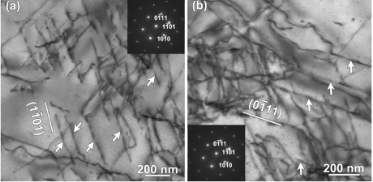
How Creep failure occurs at Ti-6Al-4V bolts
17
Figure: e BF-TEM images showing pyramidal dislocations slip along (a) (1101) plane and (b) (0111) plane in equiaxed a grains at the applied stress of 0.95σ_{0.2}
.

Slide 19
How Creep failure occurs at Ti-6Al-4V bolts
18
Summary: A summary can be described as follows. Due to the thermo-mechanical treatment of the alloy, the mobile dislocations and immobile dislocations (such as LAGBs) already existed in the grain before creep. After slipping for a certain distance, the mobile dislocations would eventually become immobile dislocations when encountering the obstacles, such as other dislocations, phase interfaces, grain boundaries and so on. And immobile dislocations can also hinder the glide of mobile dislocations. No new mobile dislocations are produced in the constant stress stage when the applied stress is low, and no random mobile dislocations are left in the grain after all mobile dislocations become immobile dislocations. Thus, the creep deformation at low temperature could no longer proceed, and the creep saturation state was reached as shown in the creep curve with applied stress of 0.88σ_{0.2}When the applied stress is high enough, new mobile dislocations are generated at the constant stress stage so that creep strain could continue to increase.

Slide 20
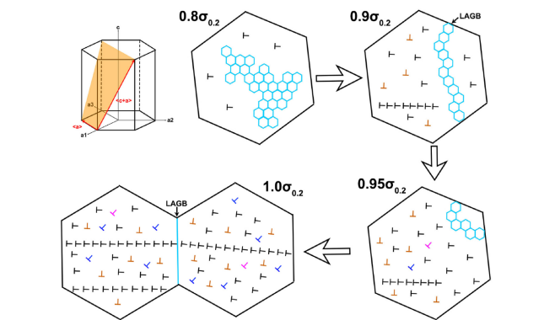
Schematic diagram
19
Figure: Schematic map of the evolution of dislocation structures with applied stresses in the low temperature creep samples

Slide 21
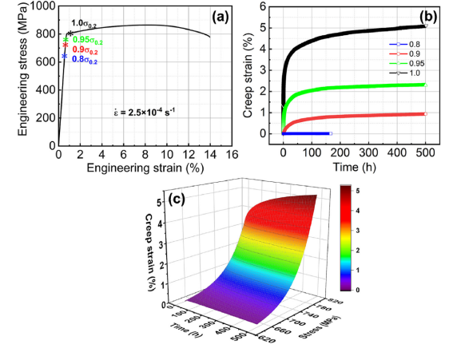
Graphical analysis of creep features of Titanium
20
Figure (a) Stress-strain curve of the tensile test at room temperature under a constant strain rate
(b) experimental creep curves and
(c) the fitting creep surface of Ti-6Al-4V alloy under different applied stresses at low temperature.

Slide 22
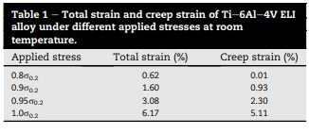
DATA TABLE:
21

Slide 23
Remedy:
22
Microstructural Modifications
Grain Size Control
Introducing second phase particles
Material Selection
Considering alternate materials
High temperature materials
Nanoprecipitation at Grain Boundary
Alloys with lower diffusion rate
Thermal analysis & Design
Analysis
Stress analysis
Regular inspection & maintenance
Monitoring
Load monitoring

Slide 24
References:
23
https://www.researchgate.net/publication/325857496_Investigation_of_In-service_Creep_Failures_of_Aircraft_Ti-6Al-4V_Bolts?fbclid=IwAR3gkfo6TzFuYYWG_M1a8RriqegYfFMZhtYFBVB4__Pye-PuRq0TG7pklqg
https://www.sciencedirect.com/science/article/pii/S223878542302450X
https://en.wikipedia.org/wiki/Coble_creep
https://www.researchgate.net/publication/256446663_An_Automated_Visual_Inspection_System_for_the_Classification_of_the_Phases_of_Ti-6Al-4V_Titanium_Alloy

Slide 25
Thank You

